Slide 1
Lesson 08 Single-Sample z-test and t-test Concepts E214 – Statistical Methods for Engineering

Slide 2
E214 – Statistical Methods for Engineering
Inferential Statistics
Hypothesis Testing
Parameter Estimation
Organize & summarize data collected
Probability and Distributions
Venn Diagram
Discrete Random Variables and Probability Distributions
Probability Distributions
Descriptive Statistics
Continuous Random Variables and Probability Distributions
Binomial Distribution
Poisson Distribution
Normal Distribution
Exponential Distribution
Tree Diagram
A more detailed topic tree on Hypothesis Testing will be given from L08 onwards

Slide 3
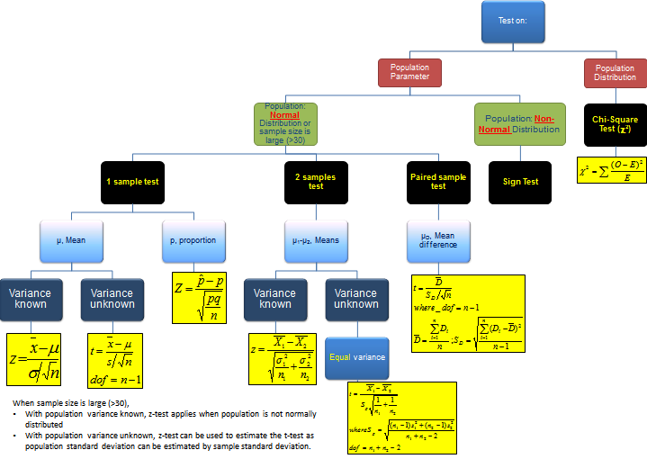
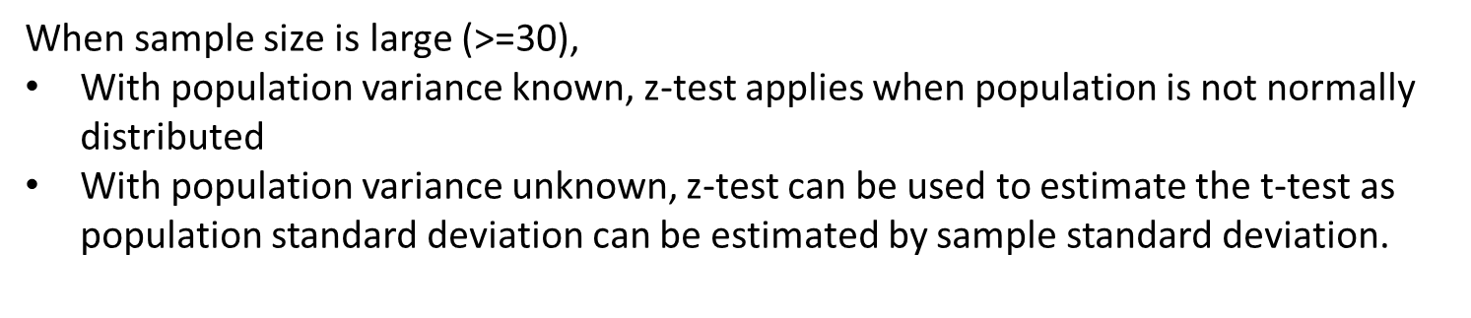
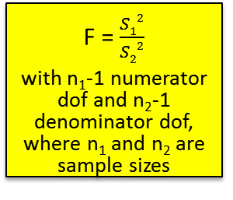
Topic Tree for Hypothesis Testing
ANOVA
A tool to compare the means of several (3 or more) populations with a single test.
L08
2 samples test on variance
σ₁² – σ₂²
F = $\frac{S12}{S22}$
with n₁-1 numerator dof and n₂-1 denominator dof, where n₁ and n₂ are sample sizes

Slide 4
Statistical Hypotheses and Hypothesis Testing
Many problems in daily life require that we decide whether to accept or reject a statement about some population parameter such as the population mean.
The statement is called a hypothesis, and the decision-making procedure about the hypothesis is called hypothesis testing.
A hypothesis is thus a claim or statement about a population parameter.

Slide 5
Overview of Hypothesis Testing Procedure
From the problem, identify the population parameter of interest.
State clearly the null hypothesis H₀ and alternative hypothesis H₁.
State clearly the level of significance of the test (if not given in problem, we can assume a typical value of 1%, 2% or 5%).
State the test statistic to be used, together with any necessary assumptions made.
Compute the value of the test statistic using the given sample data.
6. i) If using the critical region method: based on the stated level of significance , determine the critical value(s) and state the critical region.
ii) If using p-value method: based on the calculated value of the test statistic, calculate the p-value.
7. Make a decision whether to reject H₀:
i) If using critical region method: Reject H₀ if calculated test statistic falls inside the critical region. Otherwise, do not reject H_{0.}
ii) If using p-value approach: Reject H₀ if p-value < level of significance. Otherwise, do not reject H_{0.}
8. Write down a formal conclusion for the problem in its context.
5

Slide 6


Steps 1&2 – Null and Alternative Hypotheses
There are three different types of formulations for H₀ and H₁ (below example uses the population mean $μ;$ for population proportion of “success”, we just change the symbol to $p$):
Note:
The equal sign is always in H₀.
For H₁, it can take only one of 3 possible signs: ‘<‘, ‘>’, or ‘$≠$’
(i) $H_{0}: μ=μ_{0}$ ($μ_{0}$ is a value that is usually provided in the question)
$H_{1}: μ<μ_{0}$ (Lower-tailed, or left-tailed test)
(ii) $H_{0}: μ=μ_{0}$
$H_{1}: μ>μ_{0}$ (Upper-tailed, or right-tailed test)
(iii) $H_{0}: μ=μ_{0}$
$H_{1}: μ≠μ_{0}$ (Two-tailed test)

Slide 7


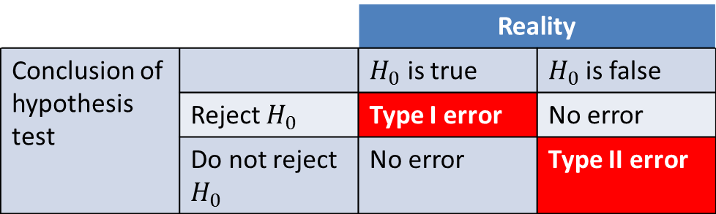
Step 3 – Level of Significance, $α$
When we conduct a hypothesis test, the result can take on one of the 4 possible scenarios below:
Generally, there are two types of errors:
Type I error: Reject H₀ given that H₀ is true
Type II error: Do not reject H₀ given that H₀ is false
 |  | Reality
Conclusion of hypothesis test |  | $H_{0}$ is true | $H_{0}$is false
 | Reject $H_{0}$ | Type I error | No error
 | Do not reject $H_{0}$ | No error | Type II error
The level of significance, $α$, is the probability of making a Type I error.
In other words, $α$ = probability of rejecting $H_{0}$ given that $H_{0}$ is true
=P(reject $H_{0}$ | $H_{0}$ is true)
*Note: For E214, we shall focus more on Type I error rather than Type II error.

Slide 8
Step 3 – Level of Significance, $α$
Before we conduct a hypothesis test, the level of 𝛼 must be stated clearly so as to limit the probability of making a Type I error.
Setting the level of significance is largely subjective and it would depend on how much we are willing to accept the consequences of rejecting H0 when H0 is true (“Type 1 error”).
For example, if we are only able to tolerate a small “Type 1 error”, like the effects of a certain medical treatment, we would set a low level of significance. On the other hand, if we can tolerate a higher “Type 1 error” like in making a business decision, we could set a higher level of significance.
Traditionally, experimenters have used either the 0.05 level (sometimes called the 5% level) or the 0.01 level (1% level). The lower the significance level, the more the data must diverge from the null hypothesis to be significant. Therefore, the 0.01 level is more conservative than the 0.05 level.

Slide 9
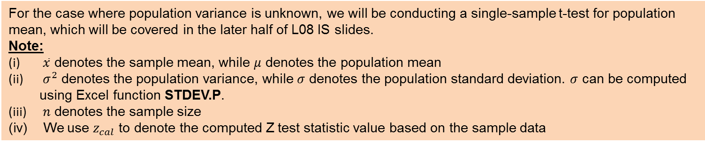
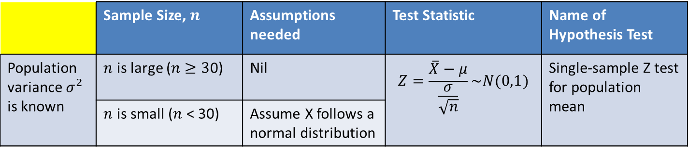
Steps 4&5 –Test Statistic
A test statistic is a sample statistic used to determine whether the decision is to “do not reject H₀” or “reject H₀”. In L08, we will be focusing on the Z- and t- test statistics. There are three types of hypothesis tests in L08:
Single-sample Z-test for population mean
Single-sample Z-test for population proportion
Single-sample t-test for population mean
Single-sample Z-test for Population Mean, $μ$
 | Sample Size, $n$ | Assumptions needed | Test Statistic | Name of Hypothesis Test
Population variance $σ^{2}$ is known | $n$ is large ($n$ $≥3$0) | Nil | $$Z=\frac{\overline{X}−μ}{\frac{σ}{\sqrt{n}}}\sim N(0,1)$$ | Single-sample Z test for population mean
 | $n$ is small ($n$ < 30) | Assume X follows a normal distribution
For the case where population variance is unknown, we will be conducting a single-sample t-test for population mean, which will be covered in the later half of L08 IS slides.
Note:
$\overline{x}$ denotes the sample mean, while $μ$ denotes the population mean
$σ^{2}$ denotes the population variance, while $σ$ denotes the population standard deviation. $σ$ can be computed using Excel function STDEV.P.
$n$ denotes the sample size
We use $z_{cal}$ to denote the computed Z test statistic value based on the sample data

Slide 10

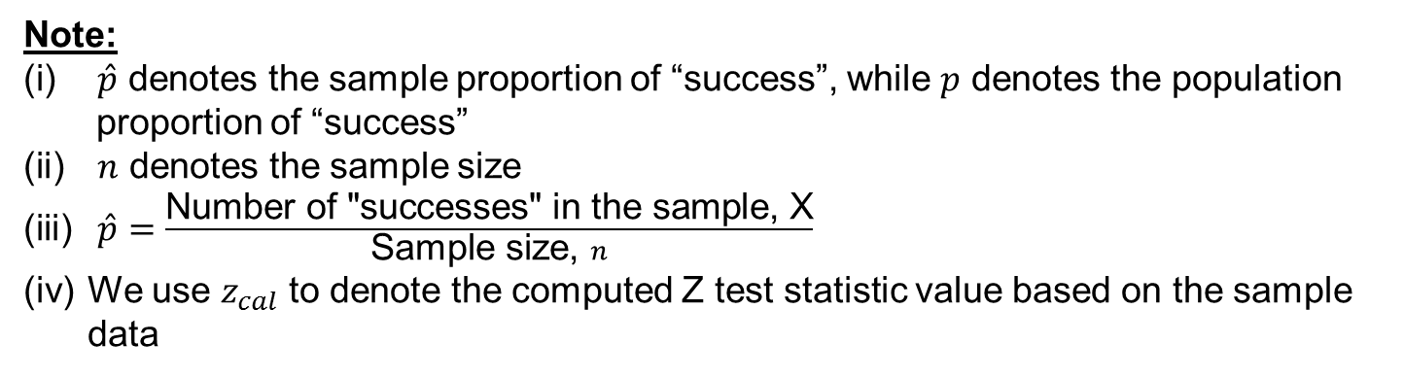

Steps 4&5 –Test Statistic
Single-sample Z-test for Population Proportion, $p$
Test Statistic:
$Z=\frac{\hat{p}−p}{\sqrt{\frac{p(1−p)}{n}}}\sim N(0,1)$
Assumption:
Sample size, $n$ is sufficiently large (usually $n≥30)$ so that the sampling distribution of the sample proportion $\hat{p}$ is approximately normal.
Note:
$\hat{p}$ denotes the sample proportion of “success”, while $p$ denotes the population proportion of “success”
$n$ denotes the sample size
$\hat{p}=\frac{\text{Number} \text{of}\text{ "}\text{successes}\text{" }\text{in} \text{the} \text{sample}\text{, }\text{X}}{\text{Sample} \text{size}\text{, }n}$
We use $z_{cal}$ to denote the computed Z test statistic value based on the sample data

Slide 11
Test Statistic – Example 1
An IQ test has been developed such that the mean score is 100 and the standard deviation is 12. In an experiment, the IQ test is administered to a random sample of 50 children living in one particular area, and the mean mark obtained was 112. The researchers want to determine, at the 5% level of significance, whether the results are able to show that children from this area are generally more intelligent.
State the null and alternative hypotheses, level of significance, and test statistic (stating any necessary assumption).
Compute the value of the test statistic using the sample data provided.

Slide 12
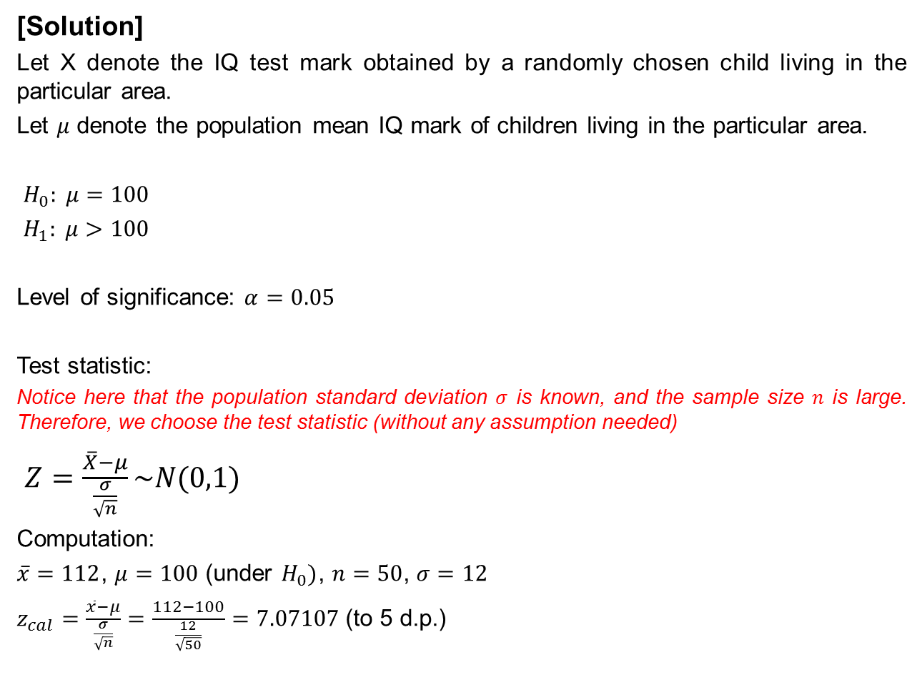
Test Statistic – Example 1
[Solution]
Let X denote the IQ test mark obtained by a randomly chosen child living in the particular area.
Let $μ$ denote the population mean IQ mark of children living in the particular area.
$H_{0}: μ=100$
$H_{1}: μ>100$
Level of significance: $α=0.05$
Test statistic:
Notice here that the population standard deviation $σ$ is known, and the sample size $n$ is large. Therefore, we choose the test statistic (without any assumption needed)
$Z=\frac{\overline{X}−μ}{\frac{σ}{\sqrt{n}}}\sim N(0,1)$
Computation:
$\overline{x}=112$, $μ=100$ (under $H_{0})$, $n=50$, $σ=12$
$z_{cal}=\frac{\overline{x}−μ}{\frac{σ}{\sqrt{n}}}=\frac{112−100}{\frac{12}{\sqrt{50}}}=7.07107$(to 5 d.p.)
Note that the population mean mark is 100, and not 112!
112 is the sample mean mark.
Remember to convert the level of significance from 5% to 5/100=0.05

Slide 13
Test Statistic – Example 2
The drug Prevnar is a vaccine meant to prevent meningitis. It is typically administered to infants. In clinical trials, the vaccine was administered to 710 randomly chosen infants between 12 and 15 months of age. Of the 710 infants, 121 experienced a loss of appetite.
A researcher wants to know if there is sufficient evidence at 1% level of significance to conclude that the proportion of infants who receive Prevnar and experience a loss of appetite is different from 0.135, the proportion of children who experience a loss of appetite with competing medications.
State the null and alternative hypotheses, level of significance, and test statistic (stating any necessary assumption).
Compute the value of the test statistic using the sample data provided.

Slide 14
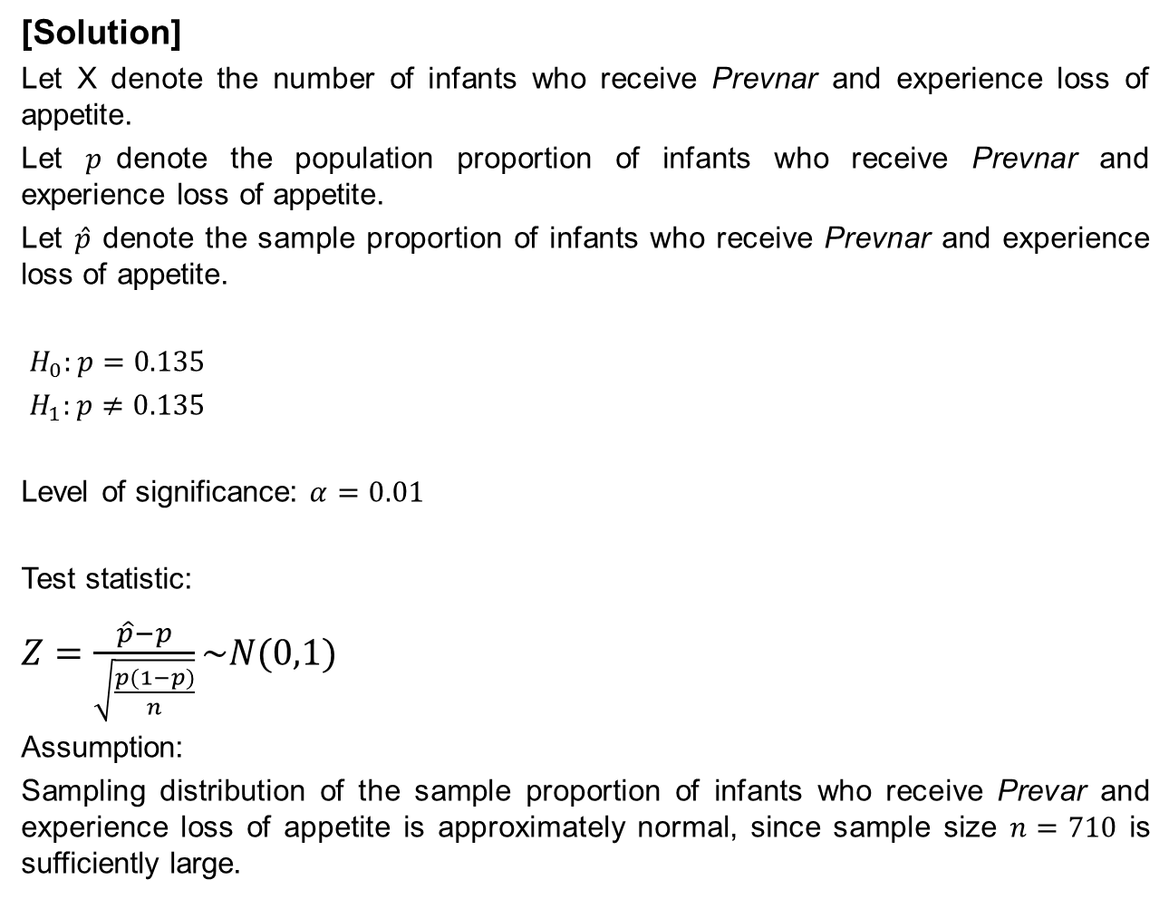
Test Statistic – Example 2
[Solution]
Let X denote the number of infants who receive Prevnar and experience loss of appetite.
Let $p$denote the population proportion of infants who receive Prevnar and experience loss of appetite.
Let $\hat{p}$ denote the sample proportion of infants who receive Prevnar and experience loss of appetite.
$H_{0}:p=0.135$
$H_{1}:p≠0.135$
Level of significance: $α=0.01$
Test statistic:
$Z=\frac{\hat{p}−p}{\sqrt{\frac{p(1−p)}{n}}}\sim N(0,1)$
Assumption:
Sampling distribution of the sample proportion of infants who receive Prevar and experience loss of appetite is approximately normal, since sample size $n=710$ is sufficiently large.

Slide 15

Test Statistic – Example 2
Computation:
$x=121, n=710, p=0.135$(under $H_{0}$)
$\hat{p}=\frac{x}{n}=\frac{121}{710}$
$z_{cal}=\frac{\hat{p}−p}{\sqrt{\frac{p(1−p)}{n}}}$
$=\frac{\frac{121}{710}−0.135}{\sqrt{\frac{0.135(1−0.135)}{710}}}$
$=2.76206$ (to 5 d.p.)

Slide 16


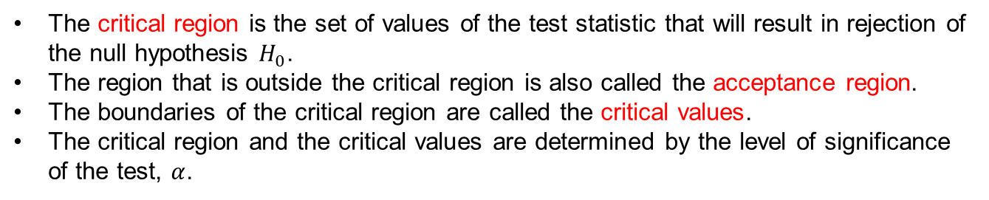



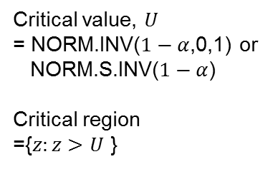
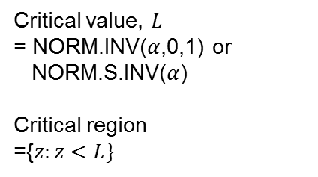







Step 6(i) – Critical Value(s) and Critical Region
The critical region is the set of values of the test statistic that will result in rejection of the null hypothesis $H_{0}$.
The region that is outside the critical region is also called the acceptance region.
The boundaries of the critical region are called the critical values.
The critical region and the critical values are determined by the level of significance of the test, $α$.
Note: The below table also applies to single-sample Z-test for population proportion, $p$
$$H_{0}:μ=μ_{0}$$
$${ H}_{1}:μ<μ_{0}$$
$$H_{0}:μ=μ_{0}$$
$${ H}_{1}:μ≠μ_{0}$$
$$H_{0}:μ=μ_{0}$$
$${ H}_{1}:μ>μ_{0}$$
(Lower-tailed test)
(Two-tailed test)
(Upper-tailed test)
Z~N(0,1)
Z~N(0,1)
Z~N(0,1)
$$α$$
$$α/2$$
$$α/2$$
$$α$$
$$L$$
0
$L$
0
$$U$$
0
$$U$$
Critical value, $L$
= NORM.INV($α$,0,1) or
NORM.S.INV($α$)
Critical region
={$z:z<L\}$
Lower critical value, $L$
= NORM.INV($\frac{α}{2},0,1)$ or NORM.S.INV($\frac{α}{2}$)
Upper critical value, $U=−L$
Critical region
= $\{z:z<L$or $z>U\}$
Critical value, $U$
= NORM.INV($1−α$,0,1) or
NORM.S.INV($1−α$)
Critical region
={$z:z>$ $U$ }

Slide 17
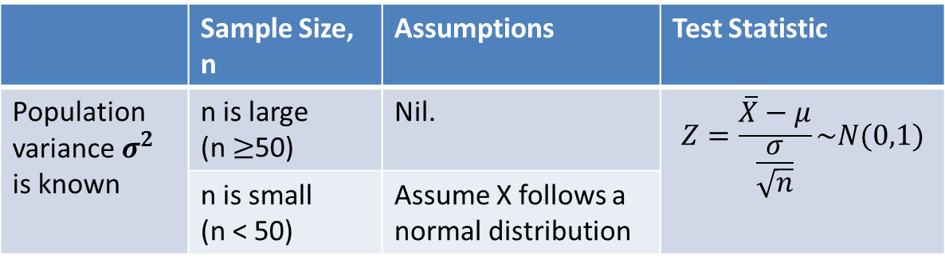
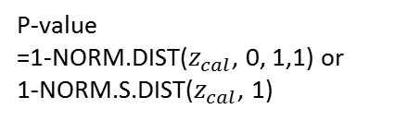
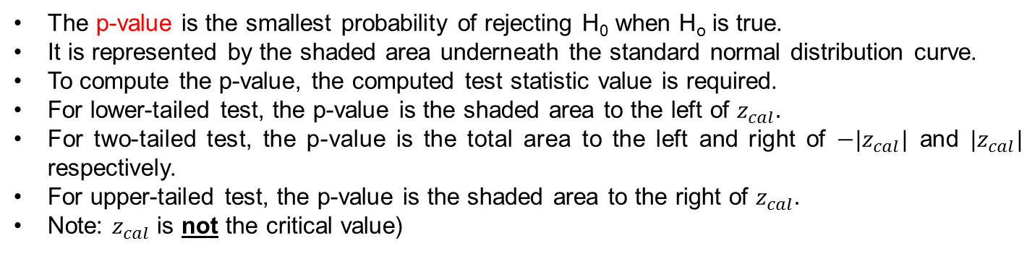


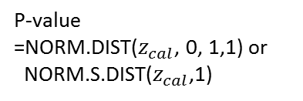

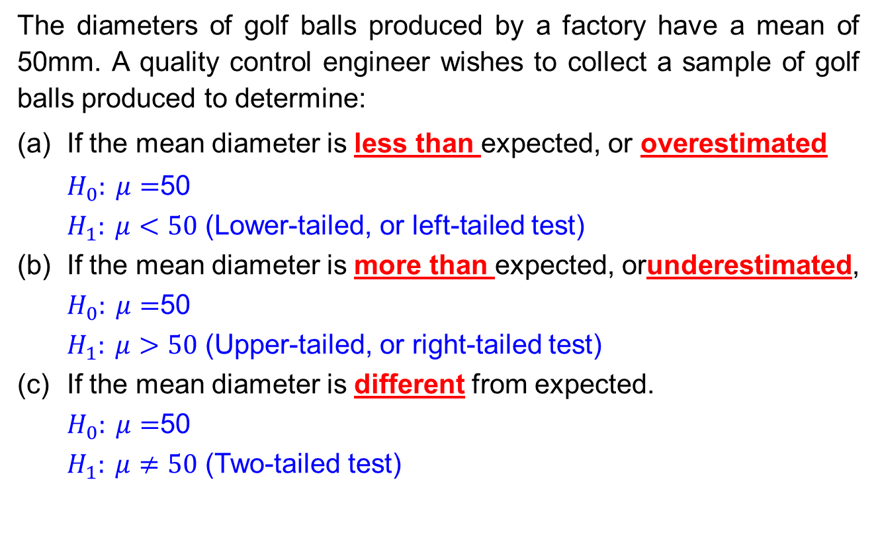
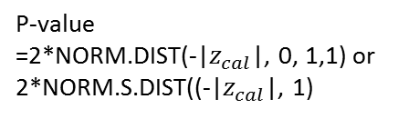

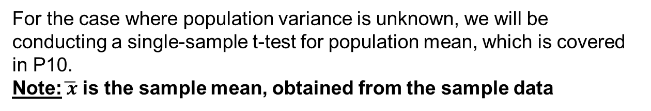

Step 6(ii) – P-value
The p-value is the smallest probability of rejecting H₀ when H_{o} is true.
It is represented by the shaded area underneath the standard normal distribution curve.
To compute the p-value, the computed test statistic value is required.
For lower-tailed test, the p-value is the shaded area to the left of $z_{cal}.$
For two-tailed test, the p-value is the total area to the left and right of $−|z_{cal}|$ and $|z_{cal}|$ respectively.
For upper-tailed test, the p-value is the shaded area to the right of $z_{cal}.$
Note: $z_{cal}$ is not the critical value)
Note: The below table also applies to single-sample Z-test for population proportion, $p$
$$H_{0}:μ=μ_{0}$$
$${ H}_{1}:μ<μ_{0}$$
$$H_{0}:μ=μ_{0}$$
$${ H}_{1}:μ≠μ_{0}$$
$$H_{0}:μ=μ_{0}$$
$${ H}_{1}:μ>μ_{0}$$
(Lower-tailed test)
(Two-tailed test)
(Upper-tailed test)
Z~N(0,1)
p-value
Z~N(0,1)
p-value
Z~N(0,1)
p-value
$$z_{cal}$$
0
-${|z}_{cal}|$
0
$${|z}_{cal}|$$
0
$$z_{cal}$$
P-value
=NORM.DIST($z_{cal}$, 0, 1,1) or
NORM.S.DIST($z_{cal}$,1)
P-value
=2*NORM.DIST(-|$z_{cal}$|, 0, 1,1) or 2*NORM.S.DIST((-|$z_{cal}$|, 1)
P-value
=1-NORM.DIST($z_{cal}$, 0, 1,1) or
1-NORM.S.DIST($z_{cal}$, 1)

Slide 18
Critical Value(s), Critical Region and P-value – Example 3
Referring back to Example 1:
An IQ test has been developed such that the mean score is 100 and the standard deviation is 12. In an experiment, the IQ test is administered to a random sample of 50 children living in one particular area, and the mean mark obtained was 112. The researchers want to determine, at the 5% level of significance, whether the results are able to show that children from this area are generally more intelligent.
Compute the critical value(s) and state the critical region for this hypothesis test.
In addition, also compute the p-value for this test.

Slide 19
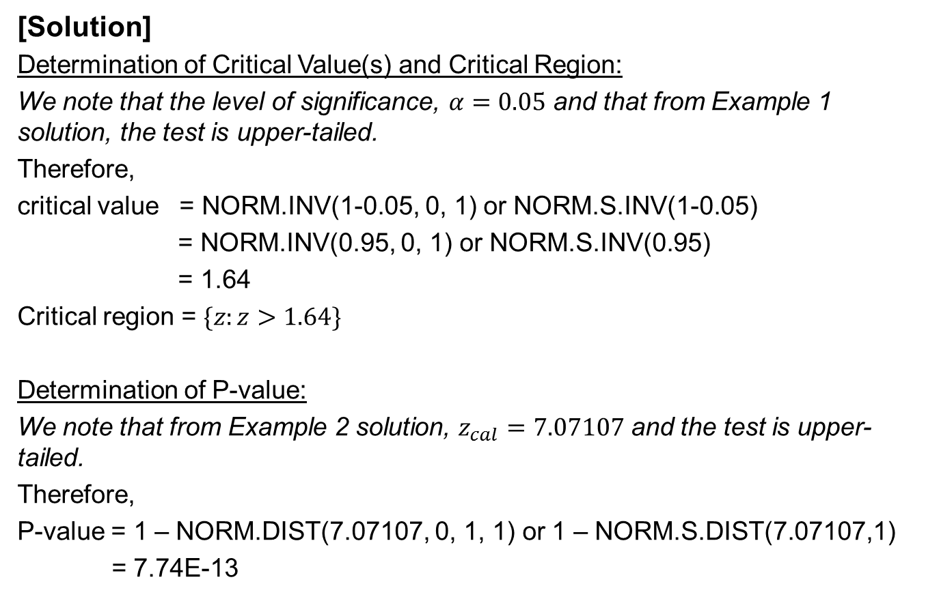
Critical Value(s), Critical Region and P-value – Example 3
[Solution]
Determination of Critical Value(s) and Critical Region:
We note that the level of significance, $α=0.05$ and that from Example 1 solution, the test is upper-tailed.
Therefore,
critical value = NORM.INV(1-0.05, 0, 1) or NORM.S.INV(1-0.05)
= NORM.INV(0.95, 0, 1) or NORM.S.INV(0.95)
= 1.64
Critical region = $\{z:z>1.64\}$
Determination of P-value:
We note that from Example 2 solution, $z_{cal}=7.07107$ and the test is upper-tailed.
Therefore,
P-value = 1 – NORM.DIST(7.07107, 0, 1, 1) or 1 – NORM.S.DIST(7.07107,1)
= 7.74E-13

Slide 20


Step 7 – Decision Rule
A decision rule is a criterion to determine whether or not to reject H₀.
Note:
Regardless of which method is used, the same decision should be reached.
If using critical region method:
Reject $H_{0}$if the computed test statistic value falls inside the critical region.
Otherwise, do not reject $H_{0}$.
If using p-value method:
Reject $H_{0}$if p-value < level of significance, $α.$
Otherwise, do not reject $H_{0}$.

Slide 21
Decision Rule – Example 4
Referring back to Example 1:
An IQ test has been developed such that the mean score is 100 and the standard deviation is 12. In an experiment, the IQ test is administered to a random sample of 50 children living in one particular area, and the mean mark obtained was 112. The researchers want to determine, at the 5% level of significance, whether the results are able to show that children from this area are generally more intelligent.
Using both critical region and p-value decision rules, determine whether or not to reject the null hypothesis.

Slide 22

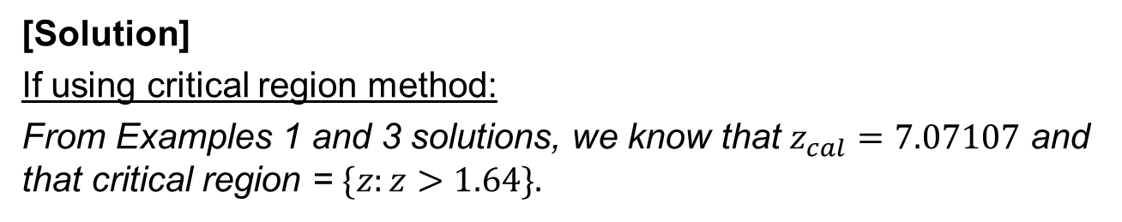
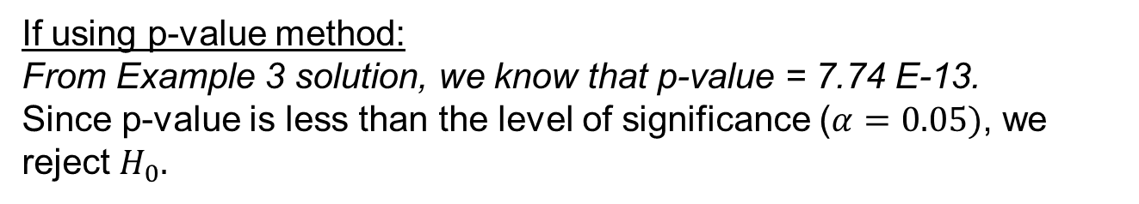


Decision Rule – Example 4
[Solution]
If using critical region method:
From Examples 1 and 3 solutions, we know that $z_{cal}=7.07107$ and that critical region = $\{z:z>1.64\}.$
Z~N(0,1)
From the diagram , we can observe that $z_{cal}$lies inside the critical region.
Hence, we reject $H_{0}.$
$$α=0.05$$
0
1.64
$$z_{cal}=7.07107$$
If using p-value method:
From Example 3 solution, we know that p-value = 7.74 E-13.
Since p-value is less than the level of significance ($α=0.05)$, we reject $H_{0}.$

Slide 23
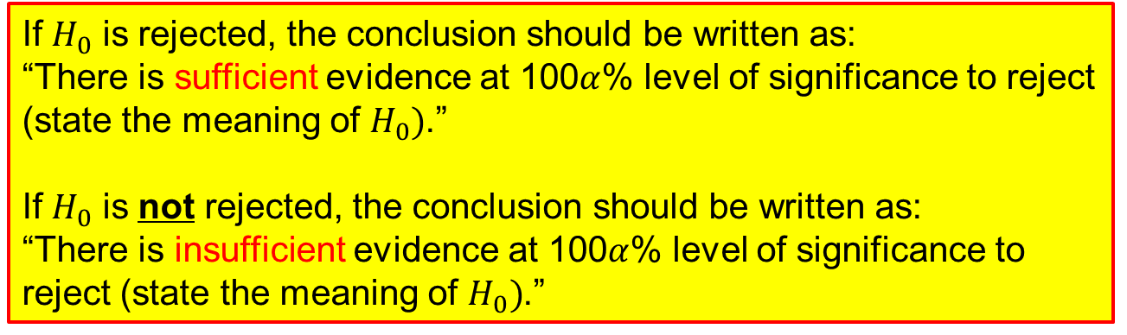
Step 8 – Writing a Formal Conclusion
If $H_{0}$ is rejected, the conclusion should be written as:
“There is sufficient evidence at 100$α$% level of significance to reject (state the meaning of $H_{0})$.”
If $H_{0}$ is not rejected, the conclusion should be written as:
“There is insufficient evidence at 100$α$% level of significance to reject (state the meaning of $H_{0})$.”

Slide 24
Single-sample Z-test for Population Mean – Example 5
According to the norms established for a mechanical aptitude test, persons who are 18 years old should average a score of 73.2 marks with a standard deviation of 8.6 marks.
If 20 randomly selected people produced a sample mean score of 76.7 marks, test whether the population mean score is underestimated at 1% level of significance.
Apply all the steps for hypothesis testing that you have learnt for the lesson so far.

Slide 25
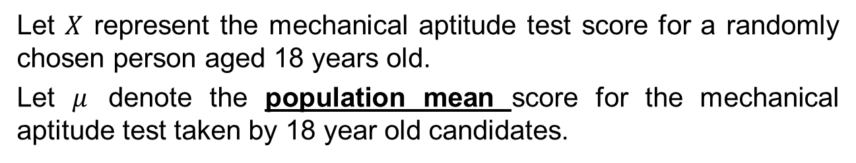
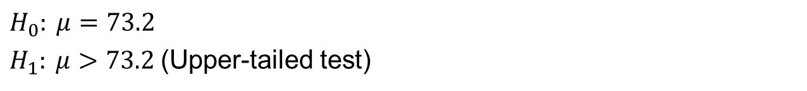
Single-sample Z-test for Population Mean – Example 5
From problem, identify the population parameter of interest.
Let $X$ represent the mechanical aptitude test score for a randomly chosen person aged 18 years old.
Let $μ$ denote the population mean score for the mechanical aptitude test taken by 18 year old candidates.
2. State clearly the null hypothesis H₀ and alternative hypothesis H₁.
$$H_{0}: μ=73.2$$ $H_{1}: μ>73.2$(Upper-tailed test)
3. State clearly the level of significance of the test (if not given in problem, we can assume typical value of 1%, 2% or 5%).
Level of significance, $α=0.01$ (given in the problem)

Slide 26
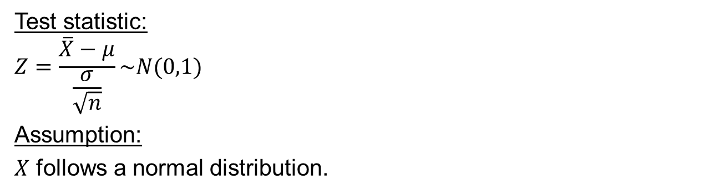
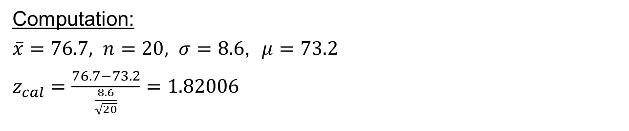
Single-sample Z-test for Population Mean – Example 5
4. State the test statistic to be used, together with any necessary assumptions made.
Test statistic:
$$Z=\frac{\overline{X}−μ}{\frac{σ}{\sqrt{n}}}\sim N(0,1)$$
Assumption:
$X$ follows a normal distribution.
5. Compute the value of the test statistic using the given sample data.
Computation:
$\overline{x}=76.7, n=20, σ=8.6$, $μ=73.2$
$z_{cal}=\frac{76.7−73.2}{\frac{8.6}{\sqrt{20}}}=1.82006$

Slide 27
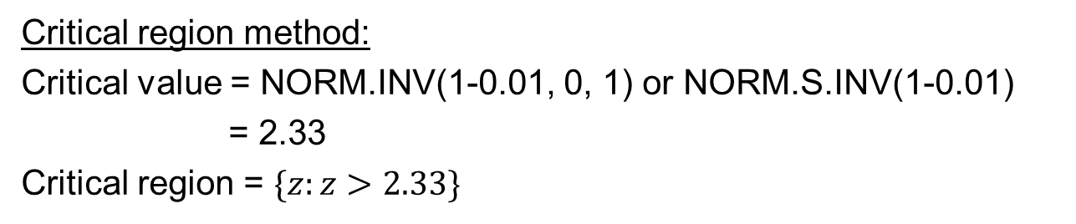
Single-sample Z-test for Population Mean – Example 5
6 i) If using the critical region method: based on the stated level of significance, determine the critical value(s) and state the critical region.
ii) If using p-value method: based on the calculated value of test statistic, calculate the p-value.
Critical region method:
Critical value = NORM.INV(1-0.01, 0, 1) or NORM.S.INV(1-0.01)
= 2.33
Critical region = $\{z:z>2.33\}$
P-value method:
P-value = 1 – NORM.DIST(1.82006, 0, 1, 1)
or 1 – NORM.S.DIST(1.82006, 1)
= 0.0344

Slide 28
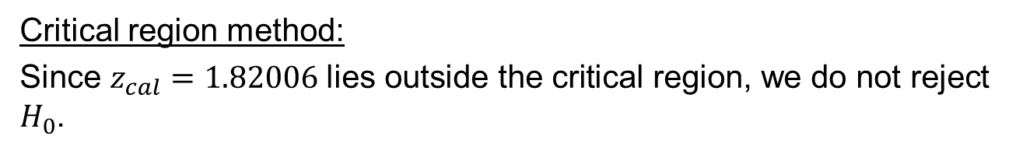

Single-sample Z-test for Population Mean – Example 5
7. Make a decision whether to reject H₀:
i) If using critical region method: Reject H₀ if calculated test statistic falls inside the critical region. Otherwise, do not reject H_{0.}
ii) If using p-value approach: Reject H₀ if p-value < level of significance. Otherwise, do not reject H_{0.}
Critical region method:
Since $z_{cal}=1.82006$lies outside the critical region, we do not reject $H_{0}$.
P-value method:
Since p-value = 0.0344 > $α\left(=0.01\right),$we do not reject $H_{0}$.
8. Write down a formal conclusion in the problem context.
There is insufficient evidence at 1% level of significance to reject the statement that the population mean score for 18 year old candidates taking the test is 73.2.

Slide 29
Single-sample Z-test for Population Proportion – Example 6
An online forum for cat lovers claims that 80% of its members are cat owners. In a random sample of 450 members, 324 of them have cats.
Conduct a suitable hypothesis test at the 5% level of significance to determine whether the forum’s claim is true.

Slide 30
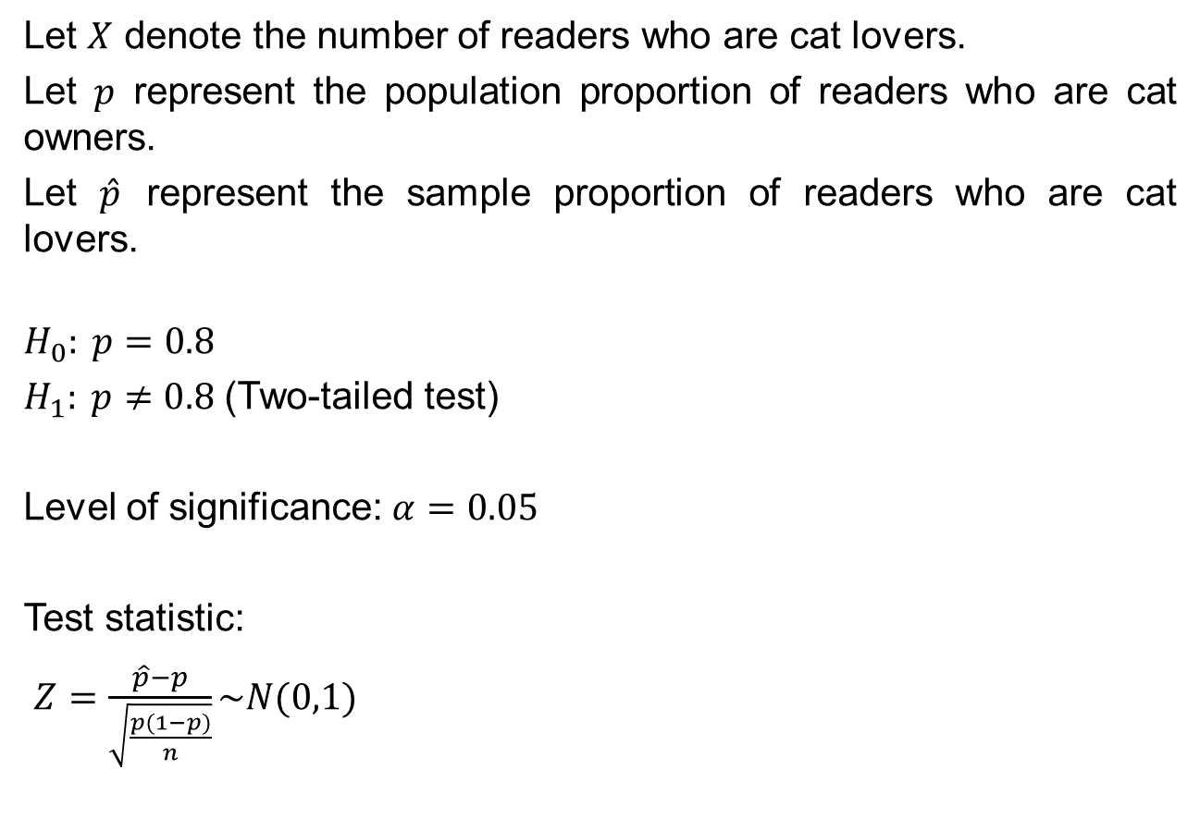
Single-sample Z-test for Population Proportion – Example 6
Let $X$ denote the number of readers who are cat lovers.
Let $p$ represent the population proportion of readers who are cat owners.
Let $\hat{p}$ represent the sample proportion of readers who are cat lovers.
$$H_{0}: p=0.8$$
$H_{1}: p≠0.8$ (Two-tailed test)
Level of significance: $α=0.05$
Test statistic:
$Z=\frac{\hat{p}−p}{\sqrt{\frac{p(1−p)}{n}}}\sim N(0,1)$

Slide 31
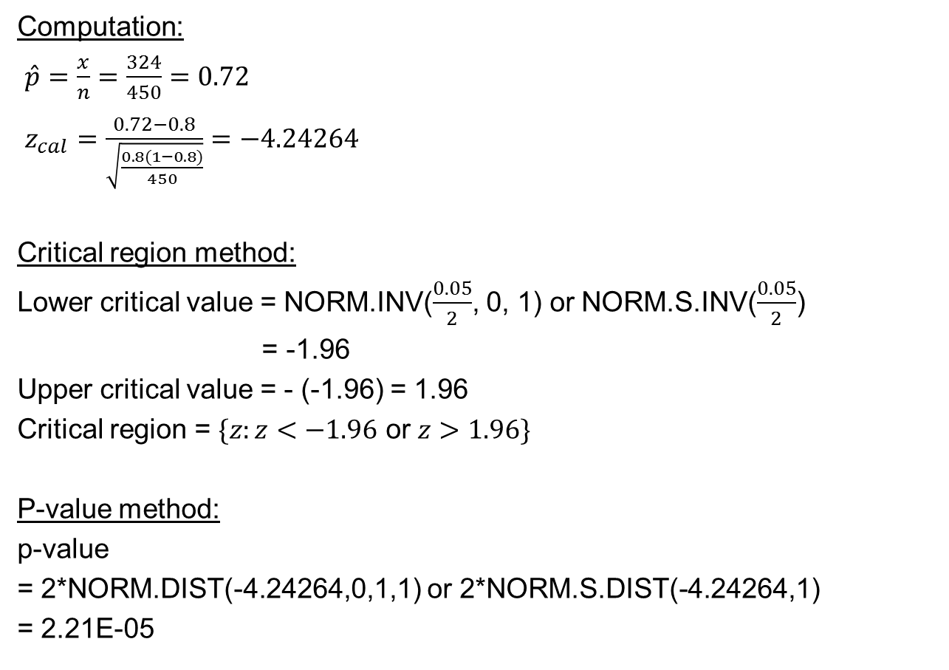
Single-sample Z-test for Population Proportion – Example 6
Computation:
$\hat{p}=\frac{x}{n}=\frac{324}{450}=0.72$
$z_{cal}=\frac{0.72−0.8}{\sqrt{\frac{0.8(1−0.8)}{450}}}=−4.24264$
Critical region method:
Lower critical value = NORM.INV($\frac{0.05}{2}$, 0, 1) or NORM.S.INV($\frac{0.05}{2}$)
= -1.96
Upper critical value = - (-1.96) = 1.96
Critical region = $\{z:z<−1.96$ or $z>1.96\}$
P-value method:
p-value
= 2*NORM.DIST(-4.24264,0,1,1) or 2*NORM.S.DIST(-4.24264,1)
= 2.21E-05

Slide 32
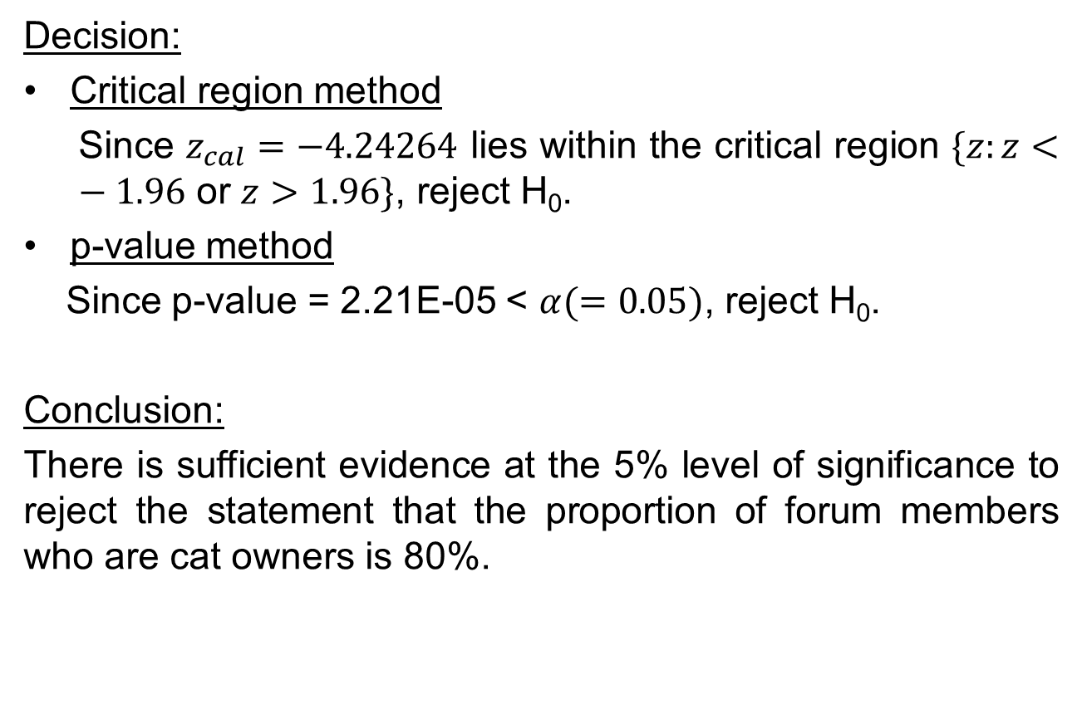
Single-sample Z-test for Population Proportion – Example 6
Decision:
Critical region method
Since $z_{cal}=−4.24264$ lies within the critical region $\{z:z<−1.96$ or $z>1.96\}$, reject H₀.
p-value method
Since p-value = 2.21E-05 < $α(=0.05)$, reject H₀.
Conclusion:
There is sufficient evidence at the 5% level of significance to reject the statement that the proportion of forum members who are cat owners is 80%.

Slide 33
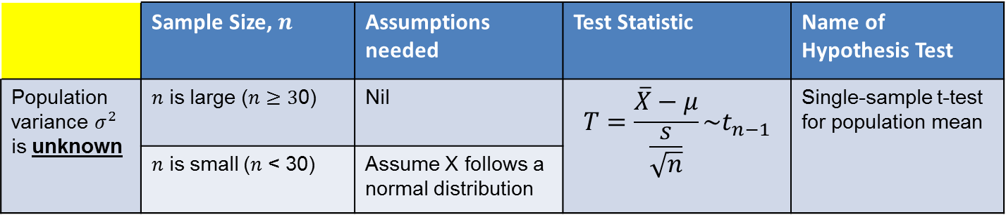
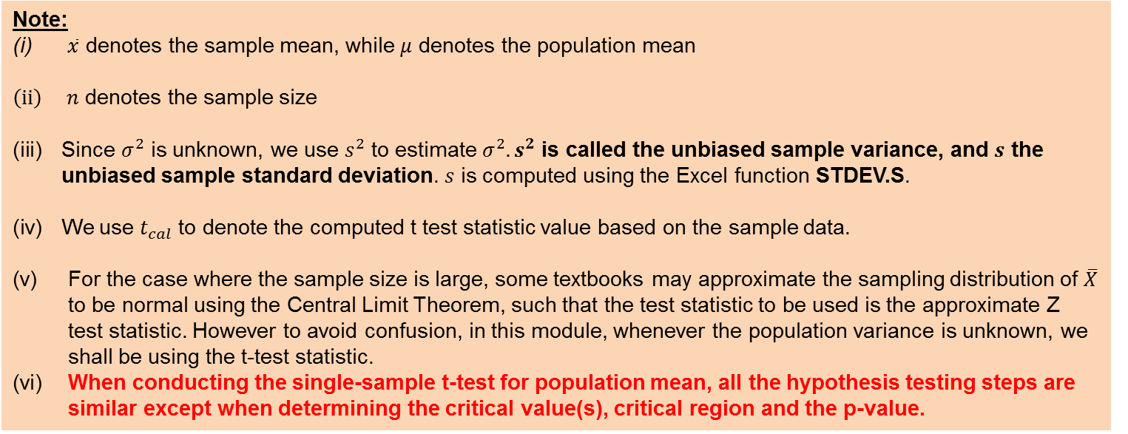
Single-sample t-test for Population Mean
Single-sample t-test for Population Mean, $μ$
 | Sample Size, $n$ | Assumptions needed | Test Statistic | Name of Hypothesis Test
Population variance $σ^{2}$ is unknown | $n$ is large ($n$ $≥3$0) | Nil | $$T=\frac{\overline{X}−μ}{\frac{s}{\sqrt{n}}}\sim t_{n−1}$$ | Single-sample t-test for population mean
 | $n$ is small ($n$ < 30) | Assume X follows a normal distribution
Note:
(i) $\overline{x}$ denotes the sample mean, while $μ$ denotes the population mean
$\left(ii\right) n$ denotes the sample size
Since $σ^{2}$ is unknown, we use $s^{2}$ to estimate $σ^{2}. s^{2}$ is called the unbiased sample variance, and $s$ the unbiased sample standard deviation. $s$ is computed using the Excel function STDEV.S.
We use $t_{cal}$ to denote the computed t test statistic value based on the sample data.
(v) For the case where the sample size is large, some textbooks may approximate the sampling distribution of $\overline{X}$ to be normal using the Central Limit Theorem, such that the test statistic to be used is the approximate Z test statistic. However to avoid confusion, in this module, whenever the population variance is unknown, we shall be using the t-test statistic.
(vi) When conducting the single-sample t-test for population mean, all the hypothesis testing steps are similar except when determining the critical value(s), critical region and the p-value.

Slide 34
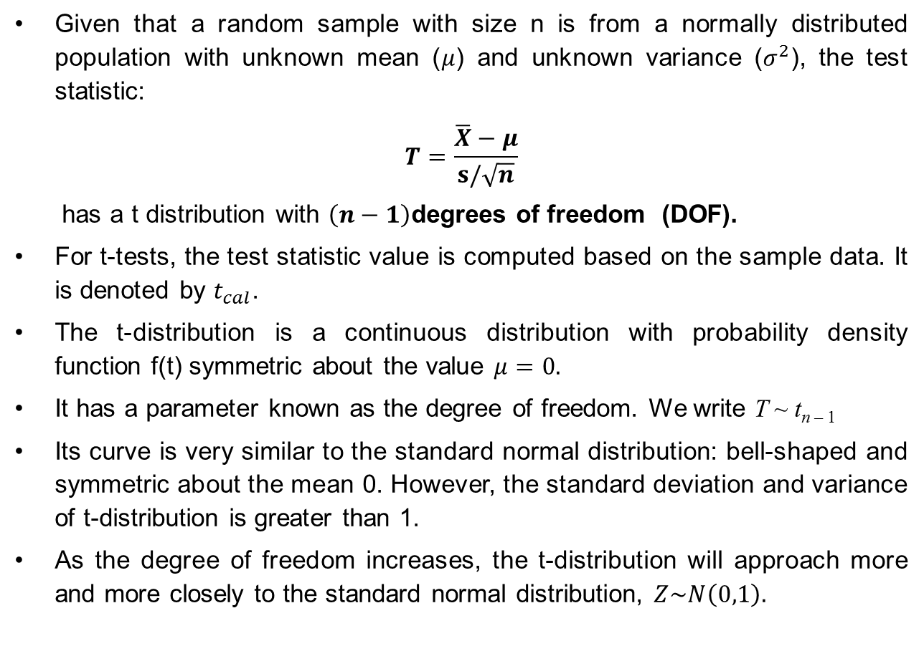
Introduction to t-distribution
Given that a random sample with size n is from a normally distributed population with unknown mean ($μ$) and unknown variance ($σ^{2}$), the test statistic:
$$T=\frac{\overline{X}−μ}{s/\sqrt{n}}$$
has a t distribution with $\left(n−1\right)$degrees of freedom (DOF).
For t-tests, the test statistic value is computed based on the sample data. It is denoted by $t_{cal}$.
The t-distribution is a continuous distribution with probability density function f(t) symmetric about the value $μ=0.$
It has a parameter known as the degree of freedom. We write T ~ t_{n – 1}
Its curve is very similar to the standard normal distribution: bell-shaped and symmetric about the mean 0. However, the standard deviation and variance of t-distribution is greater than 1.
As the degree of freedom increases, the t-distribution will approach more and more closely to the standard normal distribution, $Z\sim N\left(0,1\right).$

Slide 35
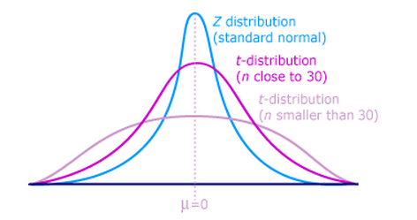
Introduction to t-distribution
T-distribution curve is very similar to the standard normal distribution: bell-shaped and symmetric about mean 0. However, the standard deviation and variance of t-distribution is greater than 1 .
As the degree of freedom associated with the t-distribution approaches infinity, the t-distribution curve will resemble more and more closely to the standard normal distribution curve.

Slide 36
















Determination of Critical Value(s) and Critical Region for Single-Sample t-test on Population Mean
$$H_{0}:μ=μ_{0}$$
$${ H}_{1}:μ<μ_{0}$$
$$H_{0}:μ=μ_{0}$$
$${ H}_{1}:μ≠μ_{0}$$
$$H_{0}:μ=μ_{0}$$
$${ H}_{1}:μ>μ_{0}$$
(Lower-tailed test)
(Two-tailed test)
(Upper-tailed test)
$$T\sim t_{n−1}$$
$$T\sim t_{n−1}$$
$$T\sim t_{n−1}$$
$$α$$
$$α/2$$
$$α/2$$
$$α$$
$L$
0
$L$
0
$$U$$
0
$$U$$
Critical value, $L$
= T.INV($α$, $n−1$)
Critical region
={$t:t<L\}$
Lower critical value, $L$
= T.INV($\frac{α}{2},n−1)$
Upper critical value, $U=−L$
Alternatively:
$U$ = T.INV.2T($α$, $n−1$)
$L$ = $−U$
Critical region
= {$t$: $t$ < $L$ or $t$ > $U$}
Critical value, $U$
= T.INV($1−α$, $n−1$)
Critical region
={$t:t>$ $U$}

Slide 37


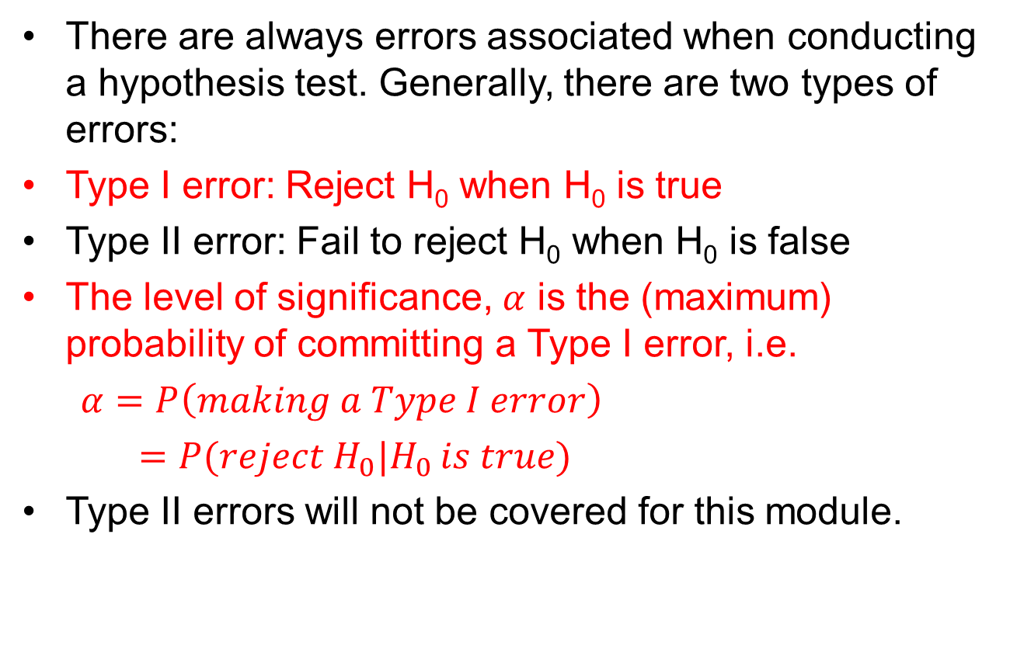






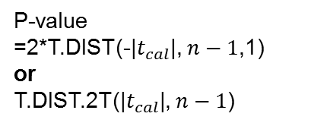
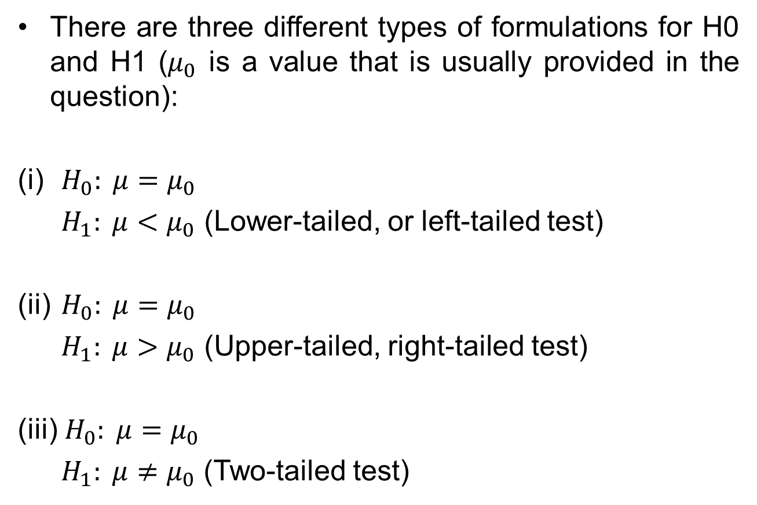


Determination of P-Value for Single-Sample t-test on Population Mean
$$H_{0}:μ=μ_{0}$$
$${ H}_{1}:μ<μ_{0}$$
$$H_{0}:μ=μ_{0}$$
$${ H}_{1}:μ≠μ_{0}$$
$$H_{0}:μ=μ_{0}$$
$${ H}_{1}:μ>μ_{0}$$
(Lower-tailed test)
(Two-tailed test)
(Upper-tailed test)
p-value
p-value
p-value
$$T\sim t_{n−1}$$
$$T\sim t_{n−1}$$
$$T\sim t_{n−1}$$
$$t_{cal}$$
0
-${|t}_{cal}|$
0
$${|t}_{cal}|$$
0
$$t_{cal}$$
P-value
=T.DIST($t_{cal}$, $n−1$, 1)
P-value
=2*T.DIST(-|$t_{cal}$|, $n−1$,1)
or
T.DIST.2T(|$t_{cal}$|, $n−1$)
P-value
=1-T.DIST($t_{cal}$, $n−1$, 1)
or
T.DIST.RT($t_{cal}$, $n−1$)

Slide 38

Single-sample t-test for Population Mean - Test Yourself
A light bulb manufacturer claims that the mean lifespan of its light bulbs is 1200 hours.
A customer suspects that the manufacturer could be overstating the mean lifespan of the light bulbs and wants to conduct a hypothesis test to verify his suspicion.
He has collected a random sample of 15 bulbs and obtained a sample mean of 1180 hours and unbiased sample standard deviation of 12 hours.
Help the customer conduct a suitable hypothesis test at 5% level of significance. State any assumption used for the test.

Slide 39
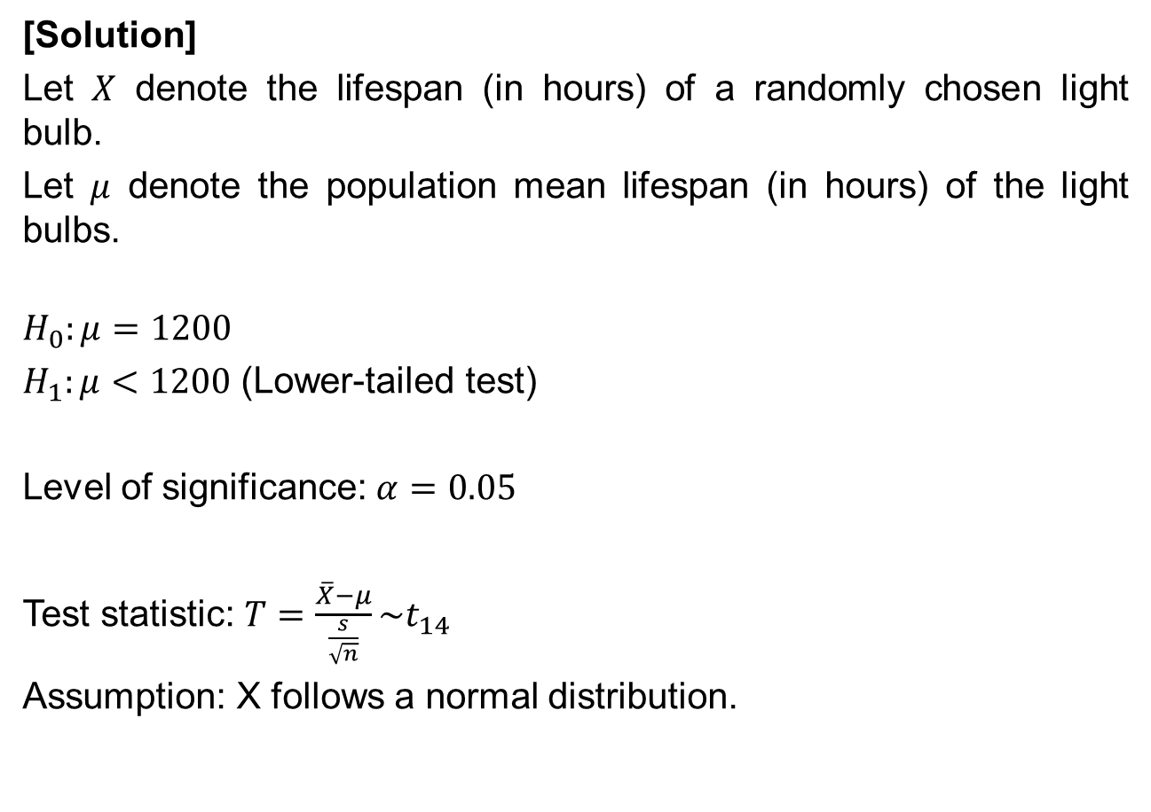
Single-sample t-test for Population Mean - Test Yourself
[Solution]
Let $X$ denote the lifespan (in hours) of a randomly chosen light bulb.
Let $μ$ denote the population mean lifespan (in hours) of the light bulbs.
$$H_{0}:μ=1200$$
$H_{1}:μ<1200$ (Lower-tailed test)
Level of significance: $α=0.05$
Test statistic: $T=\frac{\overline{X}−μ}{\frac{s}{\sqrt{n}}}\sim t_{14}$
Assumption: X follows a normal distribution.

Slide 40
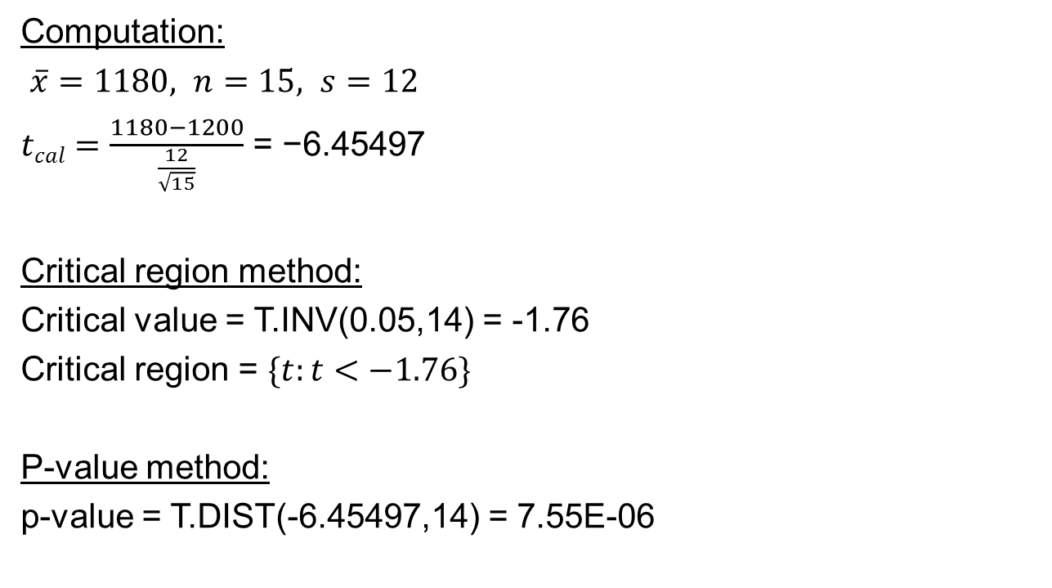
Single-sample t-test for Population Mean - Test Yourself
Computation:
$\overline{x}=1180, n=15, s=12$
$tcal=\frac{1180−1200}{\frac{12}{\sqrt{15}}}$ = −6.45497
Critical region method:
Critical value = T.INV(0.05,14) = -1.76
Critical region = $\{t:t<−1.76\}$
P-value method:
p-value = T.DIST(-6.45497,14) = 7.55E-06

Slide 41

Single-sample t-test for Population Mean - Test Yourself
Decision:
Critical region method:
Since $t_{cal}\text{= }\text{−6.45497}$lies within the critical region $\{t:t<−1.76\}$, we reject $H_{0}.$
P-value method:
Since p-value = 7.55E-06 < $α$ (=0.05), we reject H₀.
Conclusion:
There is sufficient evidence at the 5% level of significance to reject the statement that the mean lifespan of the light bulbs is 1200 hours.

Slide 42


Summary of Hypothesis Tests in L08
Single-sample Z-test for population mean
Single-sample t-test for population mean
Single-sample Z-test for population proportion
 | Sample Size, $n$ | Assumptions needed | Test Statistic | Name of Hypothesis Test
Population variance $σ^{2}$ is known | $n$ is large ($n$ $≥3$0) | Nil | $$Z=\frac{\overline{X}−μ}{\frac{σ}{\sqrt{n}}}\sim N(0,1)$$ | Single-sample Z test for population mean
 | $n$ is small ($n$< 30) | Assume X follows a normal distribution
Population variance $σ^{2}$ is unknown | $n$ is large ($n$ $≥3$0) | Nil | $$T=\frac{\overline{X}−μ}{\frac{s}{\sqrt{n}}}\sim t_{n−1}$$ | Single-sample t-test for population mean
 | $n$ is small ($n$ < 30) | Assume X follows a normal distribution

Slide 43
Learning Objectives
Perform hypothesis testing for single-sample Z-test (population mean and proportion) and single-sample t-test (population mean)
Identify Type I and II errors
43

Slide 44
E-Learning Videos
You are strongly encouraged to watch the e-learning video prepared for P08 to enhance your understanding of the main learning objectives.
You can access the e-learning videos from the following link:
https://drive.google.com/file/d/0B0VVo-P5cYtqOUNxM1JuWFdFdTA/edit?usp=sharing
http://goo.gl/uDC8z7

